Slide 1
The geography of life: Natural Systems
Without nature’s system.....no life on Earth (pg 54-56)
The atmosphere regulates temperature on Earth
This makes water available to living things in liquid form
Discuss the Hydrologic Cycle...do activity

Slide 2
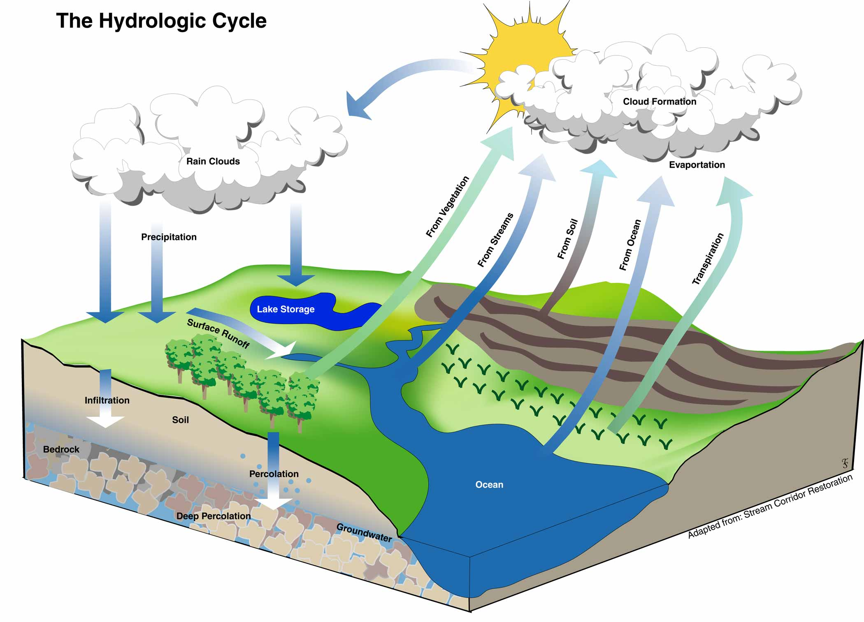

Slide 3
Water is a chemical substance that is essential to all known forms of life.
It covers 70% of Earth's surface.

Slide 4
Water:
Most of us take water for granted.
Flush toilets, run sinks, water yards. Etc
Dripping faucets waste 10 % of water piped into our homes.
Many drier areas of the world treat water as if it is gold.

Slide 5
Water:
We need water to live
2/3 of our body is water
Crops and livestock require water
Average Canadian uses 300 liters of water per day
Add production/manufacturing it is 4000 liters

Slide 6
Average daily residential water use per capita (litres per person):
United States - 425L
Canada - 326L
Italy - 250L
Sweden - 200L
France - 150L
Israel - 135L

Slide 7
W a t e r P o l l u t i o n
3 main types of water pollution:
Biological Pollution
Physical Pollution
Chemical Pollution

Slide 8
Biological Pollution
Bacteria and algae that enter lakes and rivers.
Sewage from cities and towns are the largest source.
Solved by Reducing sewage from entering water supplies (sewage treatment plants)

Slide 9
Physical Pollution
Least harmful but most obvious.
Floating garbage, paper, tin cans etc.
These are easily seen and clean-up and prevention is relative simple.

Slide 10
Chemical Pollution
Most Dangerous
Dumping of poisonous chemicals into rivers and lakes

Slide 11
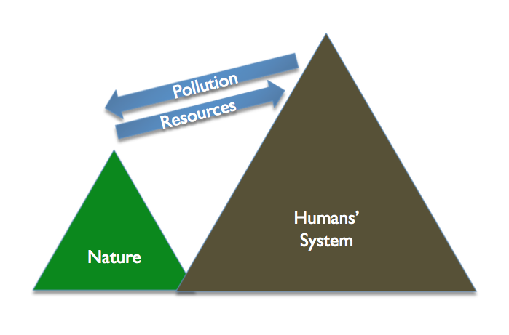
Chemical Pollution
Clean-Up there are 2 problems
Not able to completely stop chemicals from reaching water supplies
Do not have the technology to clean-up chemicals once they are in the water.

Slide 12
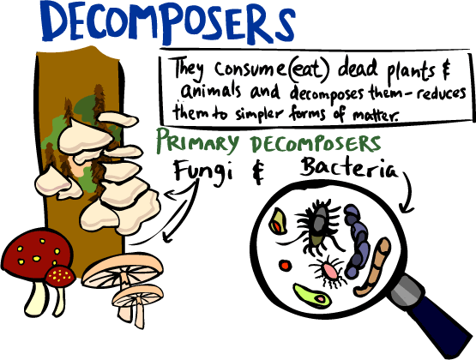
Decay Cycle
One animals waste is another Animal’s dinner.
Food Web
Decomposers
Producers
Consumers

Slide 13
Decay Cycle
There is no waste in natural systems
Creatures such as fungi and bacteria act as Decomposers:
They eat and recycle nature’s waste materials
As leaves fall to the ground, decomposers break them down down and they decay.
The remaining nutrients enrich the soil and help fallen seeds begin to grow (Germinate) on the forest floor
This leads to the growth of more trees, which eventually leads to more fallen leaves
The cycle continues…

Slide 14
Characteristics of Natural Systems
They are driven by energy from the sun
Support all living things, including humans
Are connected to one another in a complex network of relationships
Decompose and recycle all wastes
Can be affected by natural events and human influences
Are not well understood by humans
Operate on very long timelines, from hundreds to millions of years
Operate in all four of the earth’s spheres
Display synergy

Slide 15
Natural Systems
Do questions #3 on pg 57
Complete the following:
Given a natural disaster such as
Earthquake, hurricane, flood or drought)
Explain the immediate and long term consequences it would have on two natural systems in your area.

